Slide 1
Market Intraday Momentum
Sam Bolduc
Reed McDonnell
Malik Rivera
Anirudh Kamineni
10/__/2019

Slide 2
Presentation Agenda
Underlying Project Theory
Relevant Projects
Introduction to Market Intraday Momentum
Main Project Conclusions
Proposed Project
Data Collection
Replication of Prior Projects
Proposed Extensions
Project Results
Comparison to Relevant Projects

Slide 3
Underlying Project Theory
Prior time-series momentum strategies mainly focus on weekly or monthly return patterns
Posed question: can these return patterns be observed at the intraday level?
Depends on intraday market efficiencies and effects from high-frequency trading
Why first and last half-hours?
Earnings reports
Release of macroeconomic news
New Information
Market “digestion” tends to take around 30 minutes after market open based on volume segmentation

Slide 4
Relevant Projects
Market Intraday Momentum (Gao et al., 2017)
High frequency data from S&P 500 ETF from 1993-2013
Predicting last half-hour return on the first half-hour return on the market since the previous day’s market close
Statistically significant prediction findings
More significant during days of high volatility, high volume, recession days, and days if major macroeconomic news
Present among not only SPY, but also ten other actively-traded domestic and international ETFs

Slide 5

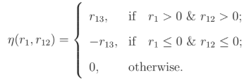
Relevant Projects cont.
Using first half-hour return as trading signal
Using first and next-to-last half-hour return as trading signal

Slide 6
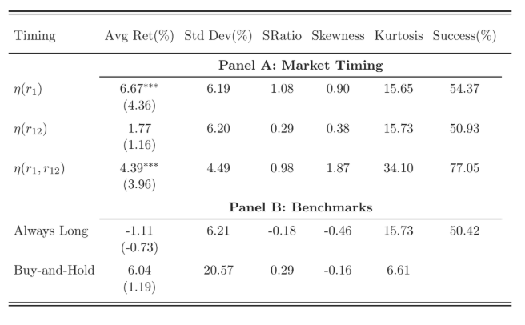
Relevant Projects cont.
Benchmark 1: Always Long
Take a long position in the market at the beginning of the last half-hour and close it after the market close
Benchmark 2: Buy-and-Hold
Take a long position in the market from the beginning of the sample and hold it until the end of the entire sample period

Slide 7
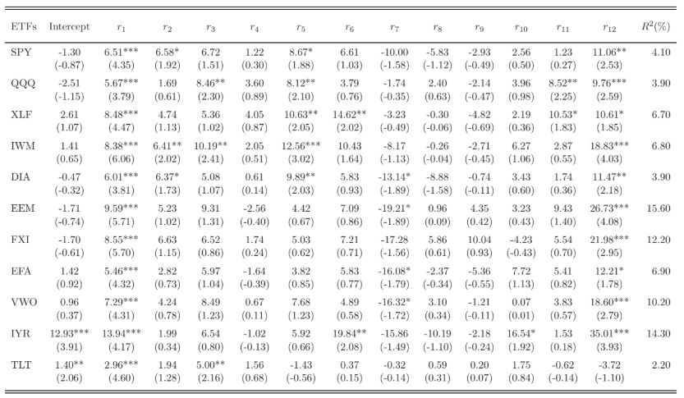
Relevant Projects cont.
Overall findings– spanning 10 other actively-traded ETFs

Slide 8
Proposed Project
Data Collection
WRDS TAQ Minute Data
WRDS TAQ Millisecond Data
Automation of data collection by ticker, data range
Replicate Prior Projects
SPY intraday momentum, similar date range and procedures
Including volatility, volume, and size as features
Observe first-order regression coefficients
Extend analysis to provided actively traded ETFs
Proposed Extensions
Expand date range, search for alpha-decay after research was published
Introduce second-order and combinational regression features
Break down the 30-minute increment into smaller time intervals

